Slide 1


Expertedge Project Performance & Insights
Prepared
by
Group C

Slide 2
TABLE OF CONTENTS
1. Executive Summary
Key Metrics & Performance Overview
2. Revenue & Budget Analysis
Total Revenue vs. Budget
Service Type Performance
3. Client & Project Analysis
Project Status & Trends
Top Clients by Revenue
4. Consultant Analysis
Utilization & Billing Rates
Top Performers
5. Key Findings & Recommendations
Insights, Risks, and Strategic Actions

Slide 3

EXECUTIVE SUMMARY
Revenue: $5.13M vs Budget $7.75M → –33.8% variance
Projects: 150
Consultants: 100 | Avg. Billing Rate: $138/hr | Utilization: 43%
Top Service: IT Strategy ($2.52M) | Lowest: Legal Compliance ($0.91M)
Top Client: Anderson Group (20% of revenue)
Key Risk: Decline in hours worked (–10% over the period under review) & uneven utilization

Slide 4
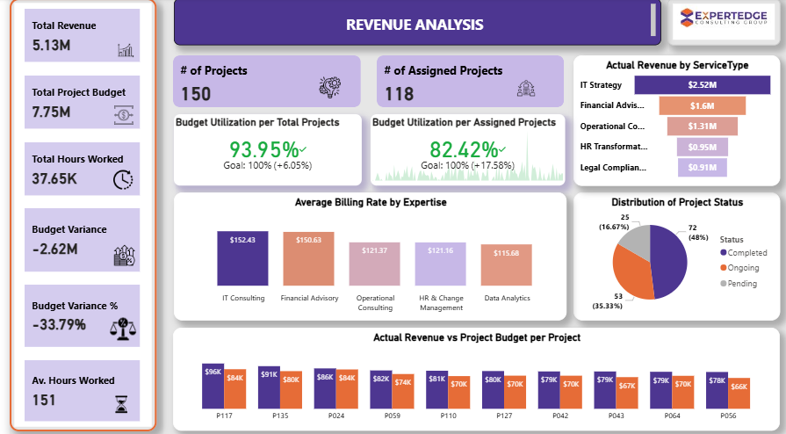

Slide 5
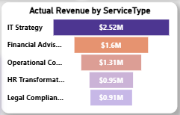
Revenue analysis
📊 Performance Overview
Total Revenue: $5.13M
Total Budget: $7.75M
Variance: –$2.62M (–33.8%)
Budget Utilization: 93.9% (Target: 100%)
Assigned Projects Utilization: 82.4% (Gap: 17.6%)
📈 Insights
Revenue and budget are positively correlated, but certain projects (e.g., P056) show major variances.
High dependence on IT Strategy suggests service concentration risk.
Budget performance is strong overall but assigned project utilization lags → signals inefficiencies.
✅ Key Takeaway Revenue growth is healthy, but budget overruns and uneven project utilization threaten profitability.

Slide 6
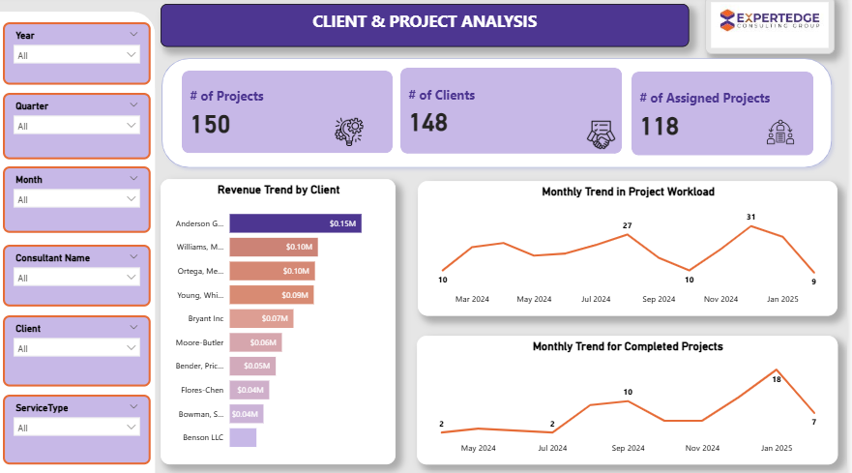

Slide 7
Monthly trend for projects workload
2024
2025
Notes:
Our project workload varies through the year. Activity starts low in February, rises by April, dips mid-year, and The pattern suggests end-of-year projects drive higher demand, while early-year months see lighter activity. peaks around December
Project workload is not evenly distributed. This seasonal pattern implies the need for careful resource planning and ensuring we have enough consultants available for the busy end-of-year months.

Slide 8
CLIENT & PROJECT ANALYSIS
🏢 Client Revenue Insights
Top Client: Anderson Group – $148.6K (20% of total revenue)
Lowest Client: Benson LLC – $30.1K (4.048% of total revenue)
Revenue is concentrated among top 3–5 clients.
💡 Key Insights
Client concentration poses dependency risk.
Strong delivery momentum in mid-2024, but workload has since declined.
Need to expand client base and stabilize project pipeline to sustain growth.
✅ Takeaway
Projects are being delivered, but declining workload and reliance on top clients highlight the need for diversification and pipeline management.

Slide 9
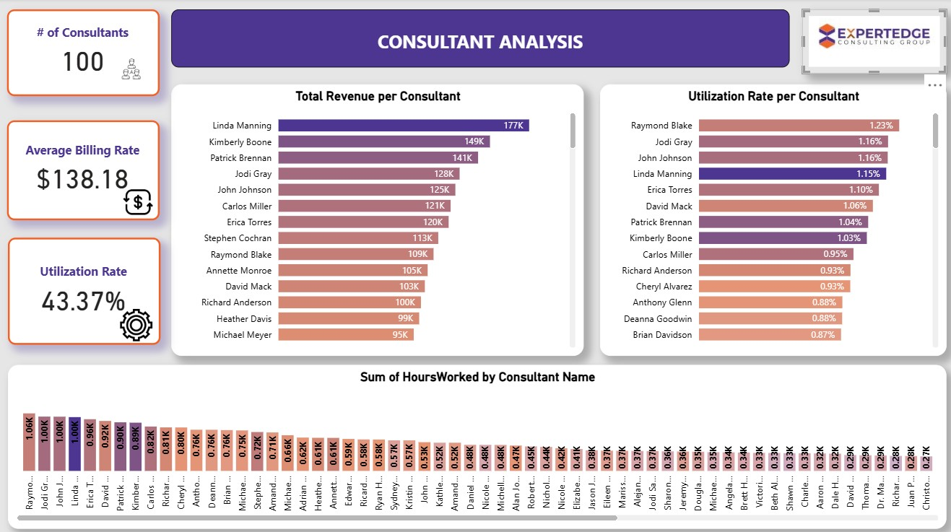
CONSULTANT ANALYSIS
Top 3 Consultants by Utilization - Raymond Blake — 1.23%, John Johnson — 1.18%, Sean Mckinney — 0.90%
Consultants with Lowest Utilization - Donna McDowell — 0.02%, Monique Moore — 0.05%, Hannah Drake — 0.06%
Top 3 Consultants by Revenue generation – Linda Manning — 1.15%, Kimberly Boone — 0.97%, Patrick Brennan — 0.92%

Slide 10
CONSULTANT ANALYSIS
High Utilization ≠ Always High Revenue
Example: Raymond Blake highest utilization rate (1.23%), highest hours worked, despite having only 1 year of experience, yet, not in the top 5 by revenue generation
High Revenue with Moderate Utilization
Linda Manning (top revenue generator at $177K) - utilization rate 1.15%, 7 years of experience yet lower hours worked
Mostly working on high-value projects despite not being the most utilized.

Slide 11
Key Insights
Across all 5 expertise, average billing rate ranged from $115.68 (Data Analytics) to $152.43 (IT Consulting)
There is a positive correlation between total sum of Actual Revenue and total sum of Project Budget
Sum of Actual Revenue and sum of Project Budget diverged the most when the ProjectID was Po56, when sum of Actual Revenue were $12,725.63281 higher than sum of Project Budget
The Budget Utilization 93.95% of the target goal

Slide 12
Key Insights
At $148,582.62 Anderson Group had the highest total revenue
At $30,143.16 Benson LLC had the lowest total revenue
Anderson Group accounted for 20.23% of the total revenue
Linda Manning had the highest sum of billed amount at 176,556.35 which is about 3.44% while Donna Mcdowell had the lowest sum of billed amount at 3,377.85 (0.07%)

Slide 13
Recommendations
1. Balance Consultant Workload
2. Optimize High-Utilization, Low-Revenue Consultants
3. Leverage High-Value Consultants Strategically
4. Plan for Seasonal Workload Peaks
5. Improve Project Forecasting
6. Diversify Revenue Base
Notes:
• Redistribute projects to reduce over-dependence on top performers.
• Upskill or reassign to higher-billing service lines.
• Position senior consultants on high-margin clients and plan succession.
• Increase staffing in December; use slow months for training and client outreach.
• Use historical data to smooth workload distribution across months.
• Enable mid-tier consultants to expand into strategic accounts.

Slide 14

THANK YOU

Slide 15




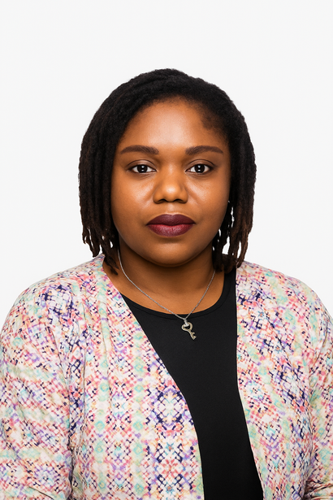

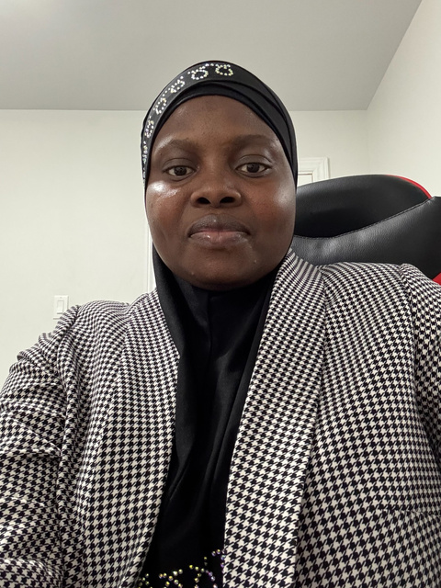

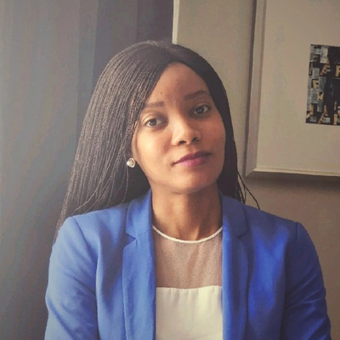

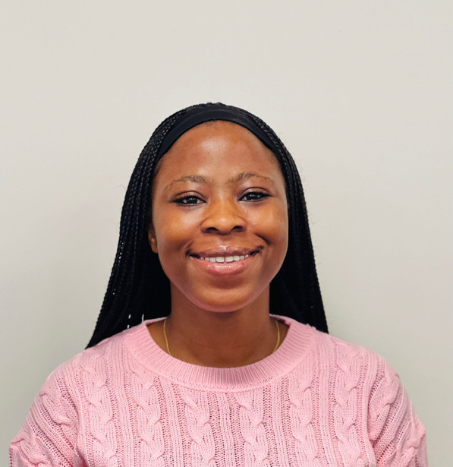
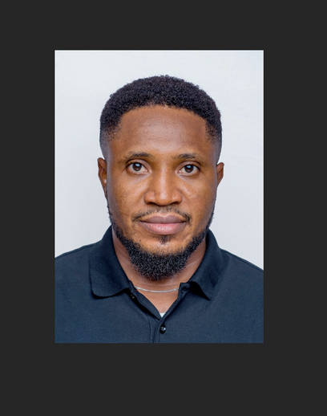

OUR TEAM
Mariah Udalor
Team Lead
Marjorie Adofo
Asst. Team Lead
Olubunmi O.
Data Analyst
Priscilla Aihoon
Data Analyst
Nurat Lawal
Data Analyst
Ngozi Oyeka
Data Analyst
Kemi Erogbogbo
Data Analyst
Chinonso N.
Data Analyst
Bola Akindele
Data Analyst
Micheal Eleri
Data Analyst
Joy Esivue
Data Analyst

Slide 16

Q&A

